Slide 1
CAR RECOGNITION
~D. SAI SNEHAN

Slide 2
ABOUT
This is a face recognition system, that can compare different faces, returning the degree of likeness. This allows identifying human faces appearing in still images or video streams by looking up face databases. Recognizing and identifying still images enables locating similar faces in driver’s license databases while helping detect duplicates. The system implements image indexing, creating compact templates for faster searching. This in turn allows building a range of security applications such as video surveillance and real-time access control systems. Many more features and higher performance are achievable in video-based surveillance systems using the new set of motion-based recognition algorithms.

Slide 3
Problem statement
In India, Road accidents continue to be a leading cause of death, disabilities and hospitalization in the country despite our commitment and efforts. India ranks first in the number of road accident deaths across the 199 countries and accounts for almost 11% of the accident related deaths in the World.
Road accident is most unwanted thing to happen to a road user, though they happen quite often. The most unfortunate thing is that we don't learn from our mistakes on road. Most of the road users are quite well aware of the general rules and safety measures while using roads but it is only the laxity on part of road users, which cause accidents and crashes. Main cause of accidents and crashes are due to human errors. We are elaborating some of the common behavior of humans which results in accident.
1.Over Speeding, 2.Drunken Driving, 3.Distractions to Driver, 4.Red Light Jumping car robbery in India had more ratio than the other countries in the world. To overcome the issues of the above problem face recognition in the cars are play a main role to avoid the problems of the car accidents and robbery in India.

Slide 4
PROPOSED SOLUTIONS
The solution for the problem statements mentioned above are to implement the machine learning to the automobile industry.
Giving a Facial recognition to the cars won't lead to accidents and robbery in the India, Face recognition is finding its way into the new generations of cars in an attempt to increase safety and convenience. From car ignition to theft prevention - there are countless possibilities of using facial recognition in cars.
Face recognition works on a simple and non-obtrusive principle. After a driver enrolls into the system, the system "remembers" them. Each time they enter the vehicle again, the system "recognizes" them and gives them access to predefined functionalities such as the permission to start the car.
The goal is to detect a potential safety threat on time. There are various ways in which the system can then intervene including audible warnings, seat vibrations, a slight take over of the vehicle control such as slowing the car down, and more. This helps avoid car accidents and keep the driver safe until they reach their destination.

Slide 5
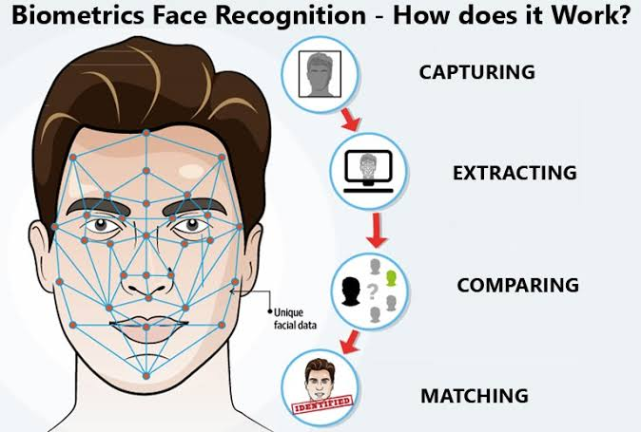

Slide 6
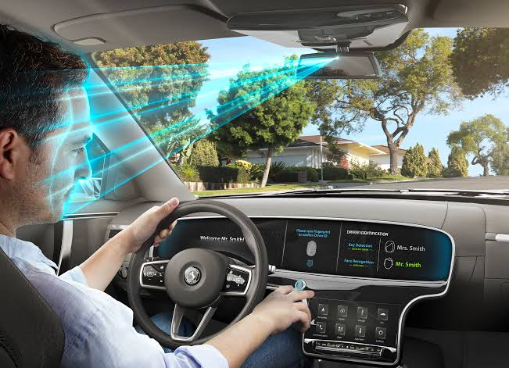

Slide 7
THANK YOU

